Slide 1
Cornerstones Website Redesign and Planning
May 7th, 2024
Evan Inglefield, Yazan Ezzedine, Aaila Imran, Jason Nice, Robert Cline, Izu Onyejekwe, & Maryum Riaz
IT 493 – Team 2: GMU Website Redesign Team – 05/07/24

Slide 2
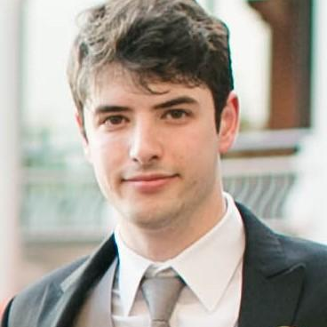
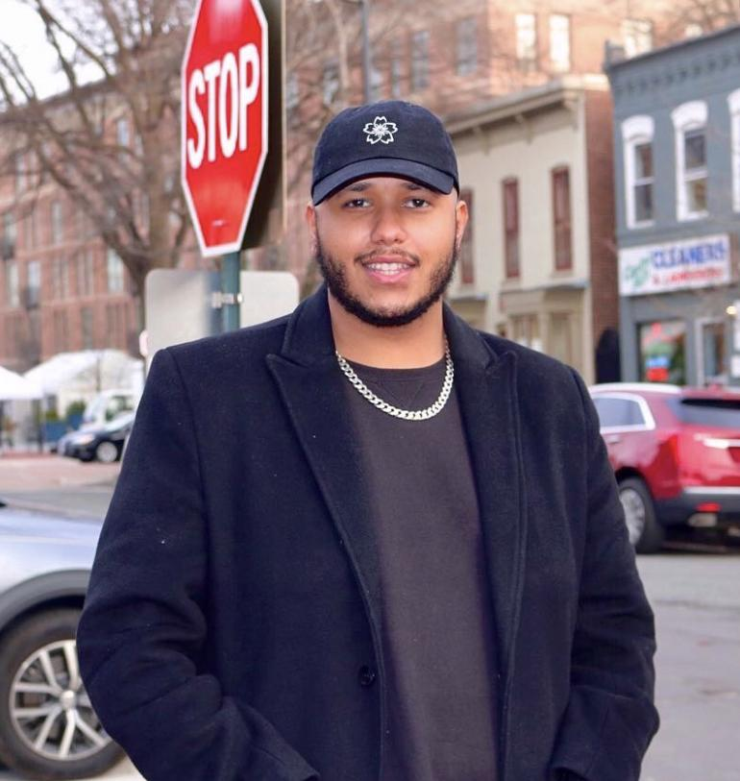
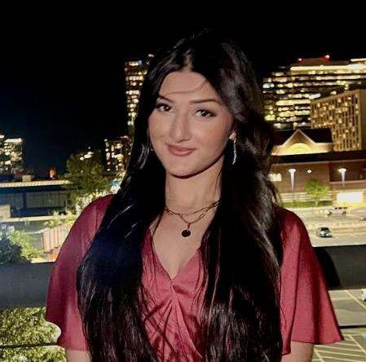
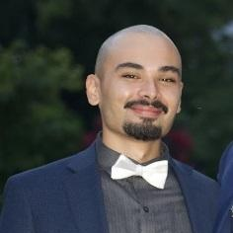
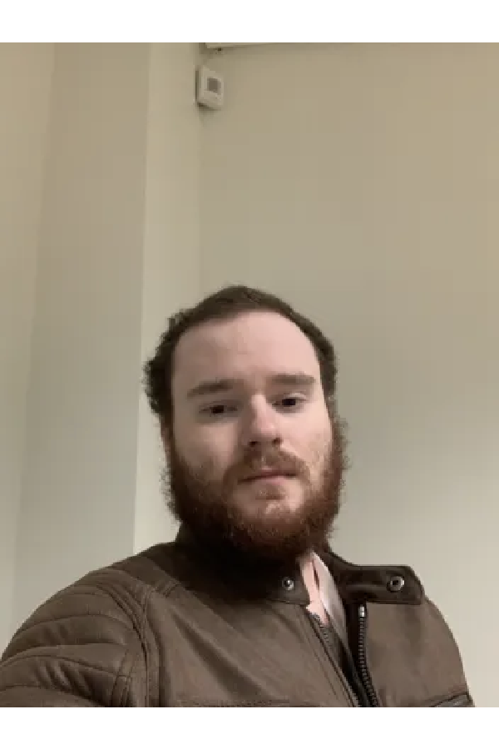
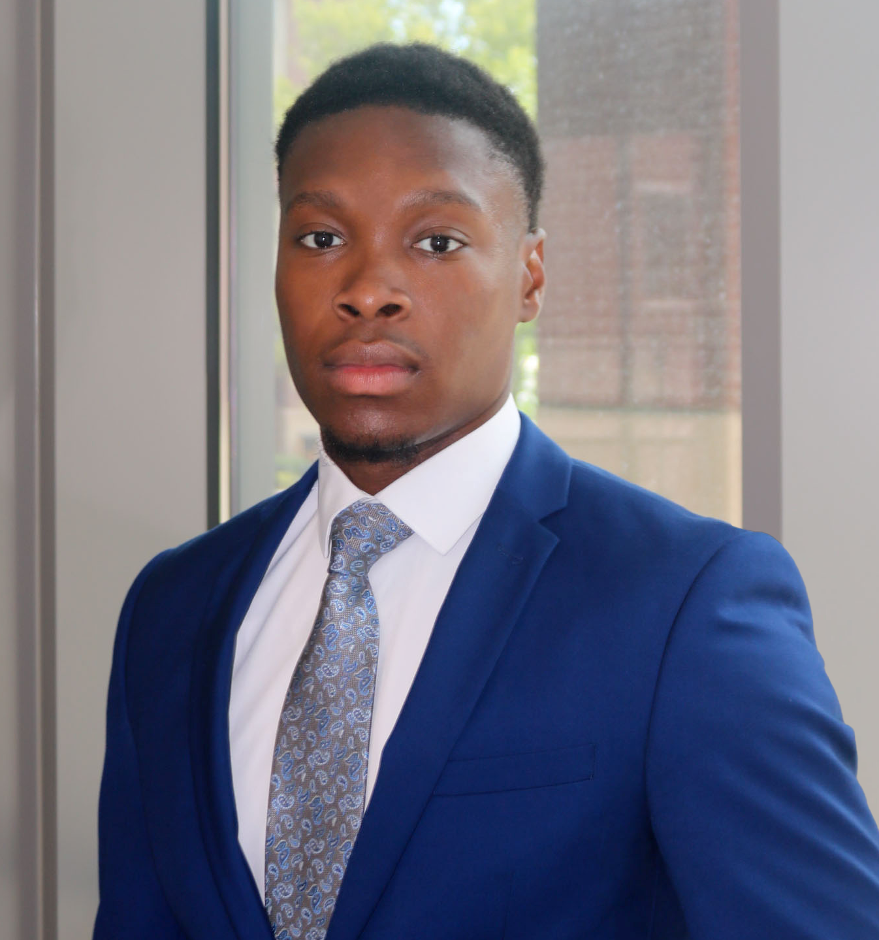
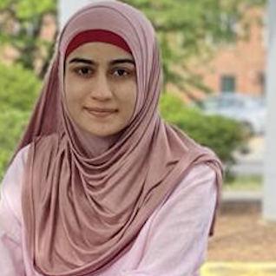
Website Redesign Team
Evan Inglefield
Yazan Ezzedine
Aaila Imran
Jason Nice
Robert Cline
Izu Onyejekwe
Maryum Riaz
IT 493 – Team 2: GMU Website Redesign Team – 05/07/24
IT 493 – Team 2: GMU Website Redesign Team – 05/07/24

Slide 3

Project Overview
By: Izu, Evan, Maryum, Yaz, & Jason
Maryum
Izu
Evan
Yazan
Jason
IT 492 – Team 2: GMU Website Redesign Team – 05/07/24

Slide 4

Overview
Izu
Cornerstones, located in Reston Virginia, is a nonprofit organization dedicated to promoting self-sufficiency and providing essential support and advocacy for those who are impacted by homelessness, unemployment, poverty and other social challenges within northwestern Fairfax County. Cornerstones provides affordable housing, emergency shelter, food assistance, childcare & other vital services.
There are multiple departments that each handle the various services Cornerstones provides.
The current website is outdated, and difficult to navigate. Our client has requested a Website Redesign Report that can assist their third-party vendor during the redesigning process in order to save time and money.
IT 492 – Team 2: GMU Website Redesign Team – 05/07/24

Slide 5

Why is the Cornerstones Website “Outdated”?
Izu
A website is considered “outdated” when compared to modern sites. Current web design trends favor minimalism, intuitive navigation, and responsive designs that work well on both desktop and mobile devices. The Cornerstones website is lacking those elements.
The site information is not updated regularly and current events information is not displayed when clicked on.
IT 492 – Team 2: GMU Website Redesign Team – 05/07/24

Slide 6
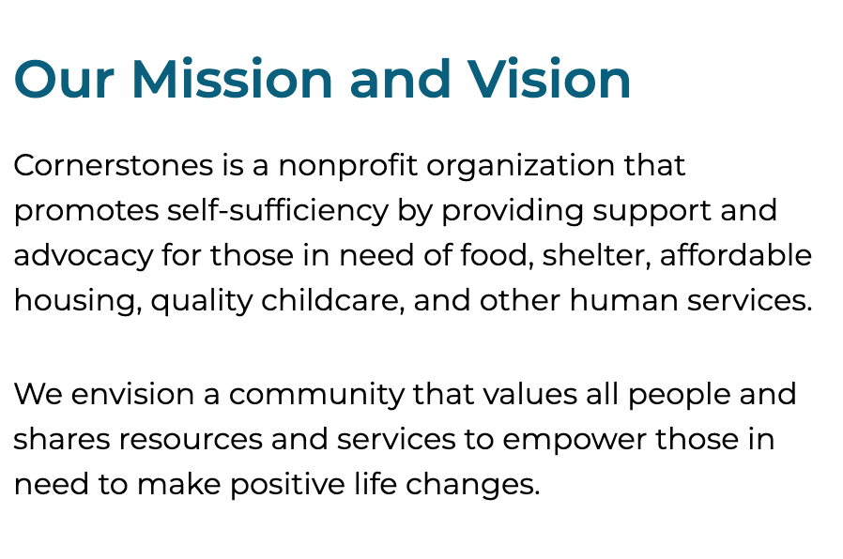
Why Our Team Chose Cornerstones?
Maryum
Cornerstones Mission & Vision:
Our Client Margaret Anne requested to work on project for the Cornerstones Personas & website redesign report . Our team choose this project because we believe in Cornerstones’ mission and understand their impact on our community.
IT 492 – Team 2: GMU Website Redesign Team – 05/07/24

Slide 7
Project objective:
The main goal of this project was to create Personas & Website Redesign Process Report that contains all element needed for a redesign.
Evan
IT 493 – Team 2: GMU Website Redesign Team – 05/07/24

Slide 8
Target audience of Cornerstones’ Website
Maryum
The target audience of Cornerstones’ Website include:
Prospective Donors
Potential Volunteers
People who use & seek Cornerstones Services
Media
IT 493 – Team 2: GMU Website Redesign Team – 05/07/24

Slide 9
Proposed deliverables
Yazan
Deliverable 1
Site-Map(Bonus for our Client).
Deliverable 1
Personas with the Key-Messages (Clients main focus, created different personas for donors, volunteers, faith-based organizations, media, and users)
Deliverable 2
Mock Web-Pages (Ways to improve the current Cornerstones main page)
Deliverable 3
Documentation Report for the Cornerstones’ Website Redesign Process (60 page final deliverable showcasing site flaws, solutions, and other deliverables)
IT 493 – Team 2: GMU Website Redesign Team – 05/07/24

Slide 10
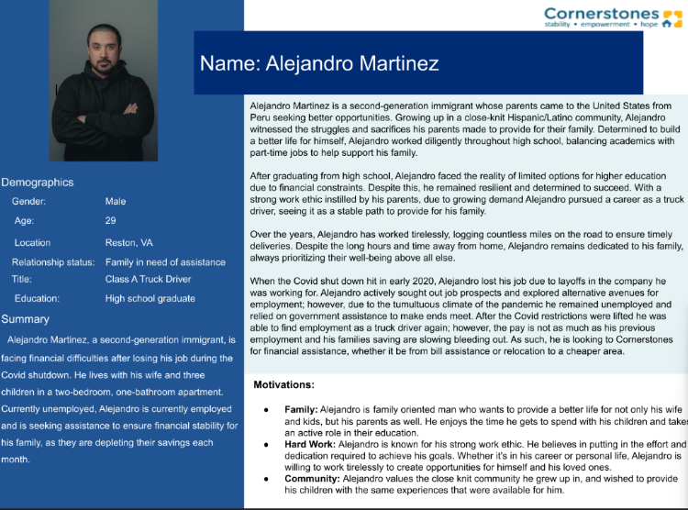
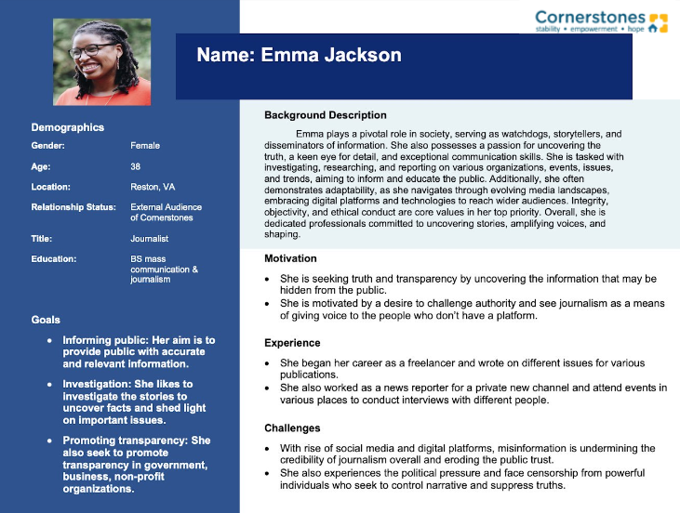
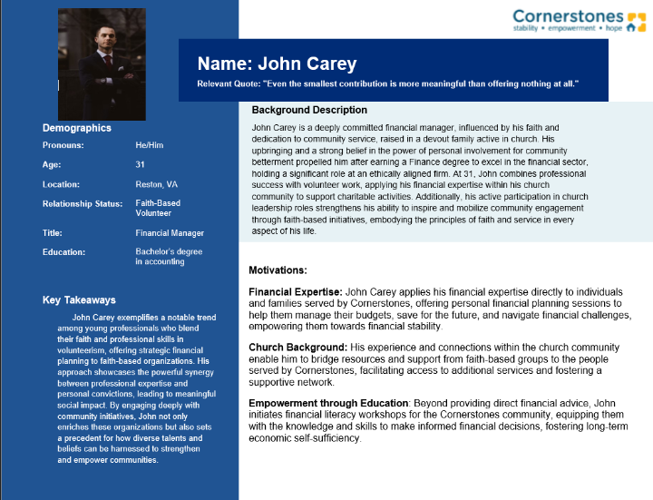
Personas
Yazan
Overall, we created a total of 8 different personas using the USDA’s persona template embodying:
Corporate donors, corporate volunteers
Faith-based donors, and faith-based volunteers
Individual donors, and individual volunteers
Individuals in need of Cornerstones’ services
Media

Slide 11
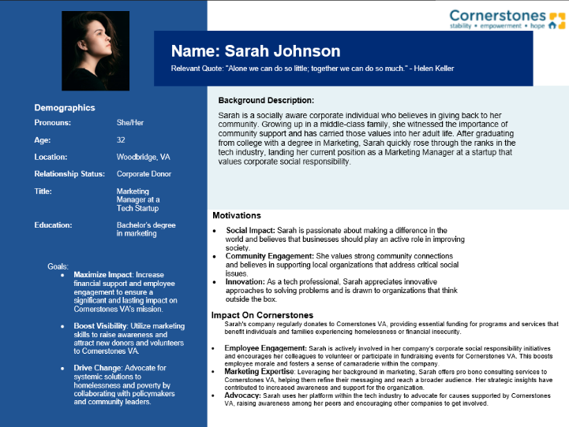
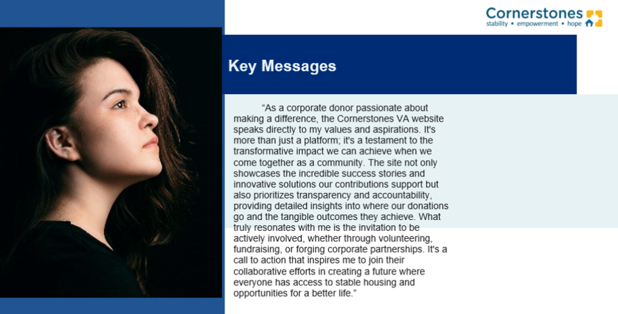
Persona Example: Corporate Donor Sarah Johnson
Yazan

Slide 12

Business Case for Change
Cornerstones website is lacking usability due to misaligned tabs and dead links (Event tab)
It is not compliant and has no alternative text
“Get Help” is a vital page but needs to be simplified for client usage
Izu
IT 492 – Team 2: GMU Website Redesign Team – 05/07/24

Slide 13
Business Process
Evan
Website Redesigning Process:
Understand organization needs (complete)
Identify technical and compliance issues (complete)
Analyze competitors (complete)
Define technical solutions (complete)
Implement solutions (vendor)
Test (vendor)
Deploy (vendor)
IT 492 – Team 2: GMU Website Redesign Team – 05/07/24

Slide 14

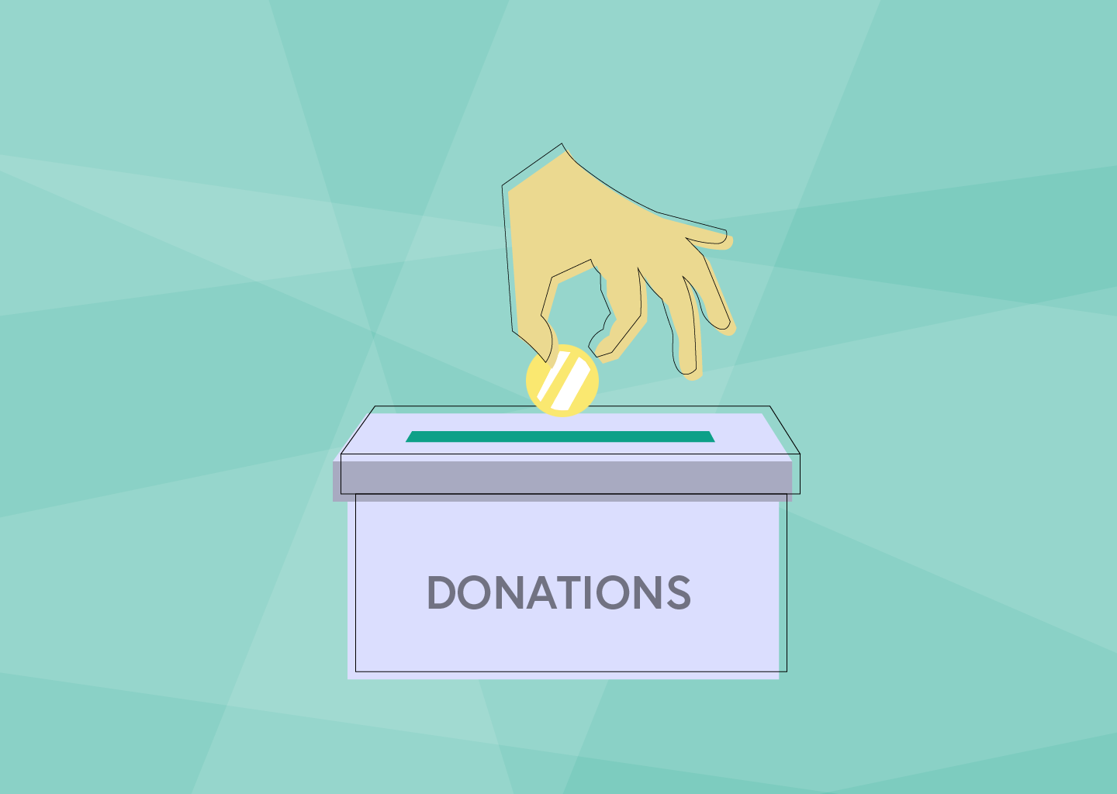
Business Impact
Jason
The website redesign analysis will impact the Cornerstones business by:
Meeting industry standards
Adhering to accessibility and compliance standards
Aligning with user and stakeholder needs
Representing Cornerstones’ mission
Completing the discovery phase of the redesign process
IT 492 – Team 2: GMU Website Redesign Team – 05/07/24

Slide 15
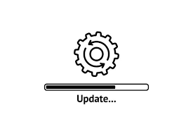
Quantified Impact of Changed Process
Izu
Modernization of the website will increase accessibility and highlighting of Cornerstones’ resources and aid to clients
Donors, employees, and clients will be able to access the site more efficiently as load times for pages will decrease
IT 492 – Team 2: GMU Website Redesign Team – 05/07/24

Slide 16

IT Solutions: By Robert
Robert
IT 492 – Team 2: GMU Website Redesign Team – 05/07/24

Slide 17
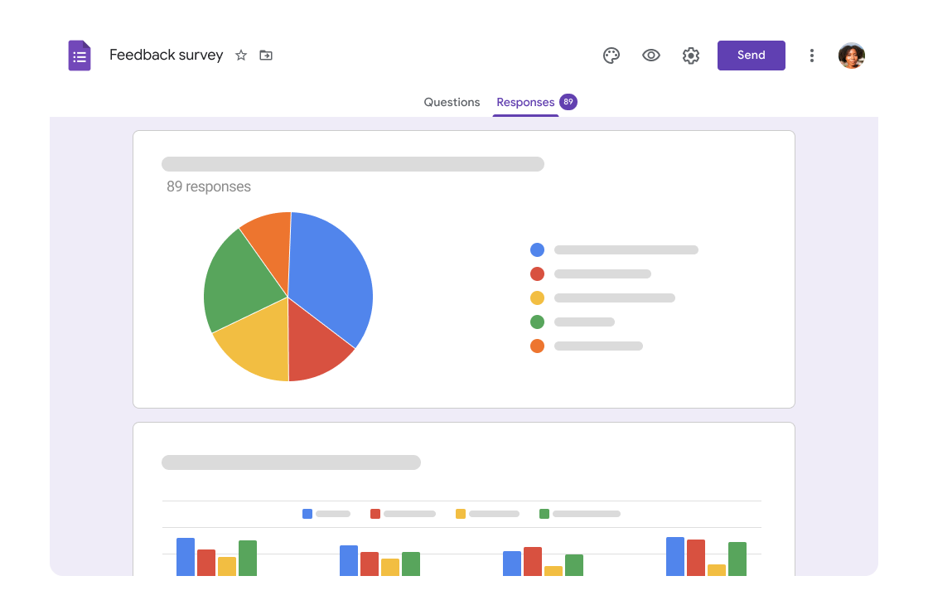
Solution is Innovative & Addresses Major Issues
Robert
IT 492 – Team 2: GMU Website Redesign Team – 05/07/24

Slide 18
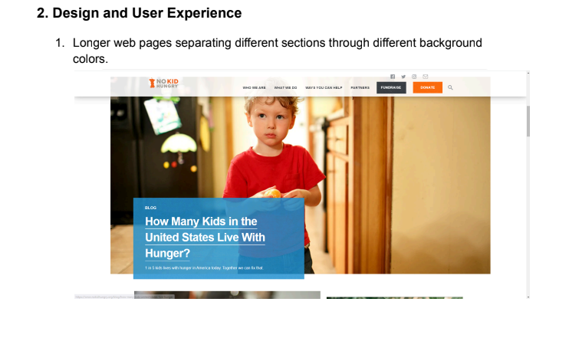
Solution is Innovative & Addresses Major Issues
Robert
IT 492 – Team 2: GMU Website Redesign Team – 05/07/24

Slide 19
Solution is Innovative & Addresses Major Issues
Actionable Insights
Consistent Branding: Maintain a consistent overall design and branding elements across all center pages.
Distinct Landing Pages: Develop dedicated landing pages for each center highlighting unique features, services, and events.
Mobile Optimization: With the increasing prevalence of mobile devices, ensuring seamless and responsive design.
Adaptive Content loading: Utilizing web design techniques such as conditional loading, and progressive enhancement to allow users with poor connection to access and utilize the web resource.
Visual Storytelling: Compelling visuals, including videos, infographics, and user testimonials, play a pivotal role in conveying company culture, values, and mission goals.
Accessibility Standards: Adhere to web accessibility standards (such as WCAG guidelines) to ensure that users of all abilities can access and interact with the content effectively.
Robert
IT 492 – Team 2: GMU Website Redesign Team – 05/07/24

Slide 20
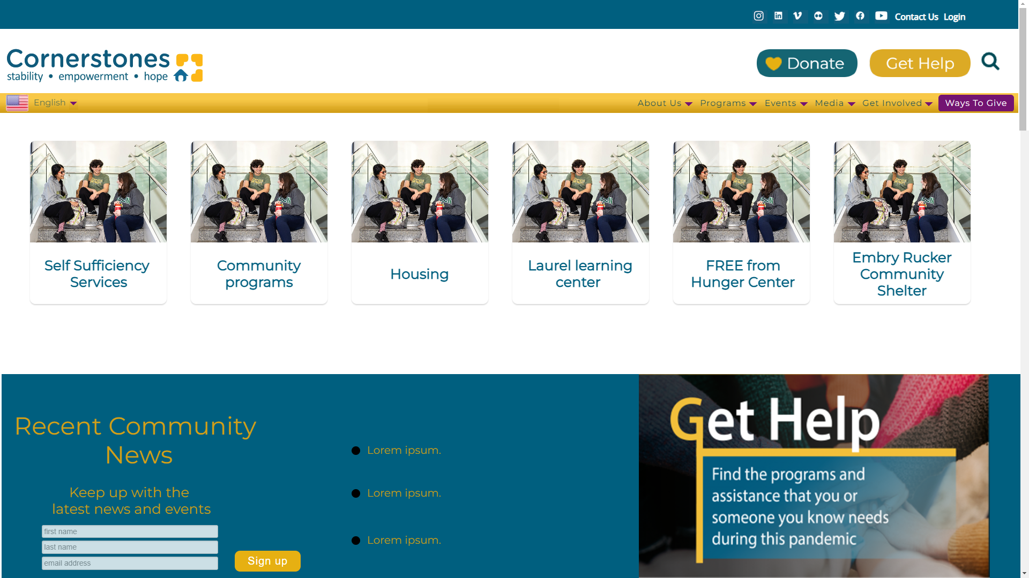
Mock Page
Robert
IT 492 – Team 2: GMU Website Redesign Team – 05/07/24

Slide 21

Implementation Challenges & Documentation Report
By: Aaila, Evan, Maryum & Jason
Jason
Aaila
Maryum
Evan
IT 492 – Team 2: GMU Website Redesign Team – 05/07/24

Slide 22
Risks
Jason
Identified Risks:
Multiple stakeholders with diverse needs.
Delays in resources and feedback from our sponsor.
Scheduling conflicts with sponsor.
Risk Mitigation:
Setting stakeholder expectations of project deliverables.
Frequent correspondence to sponsor from the team.
Emphasized in person meetings with sponsor.
IT 493 – Team 2: GMU Website Redesign Team – 05/07/24

Slide 23
Implementation Challenges
Aaila
Agile method leading to delays
Scope crush, larger scope in the original proposal
Communication inconsistencies leading to delays in execution
Communication
IT 493 – Team 2: GMU Website Redesign Team – 05/07/24
Notes:
Our team used agile method throughout the project. It did lead to delays because of wanting our sponsor, margaret anne’s feedback Scope crush, we had a larger scope in our original proposal than what we worked with this semester. Lastly, our communication inconsistencies that led to delays in our execution.

Slide 24
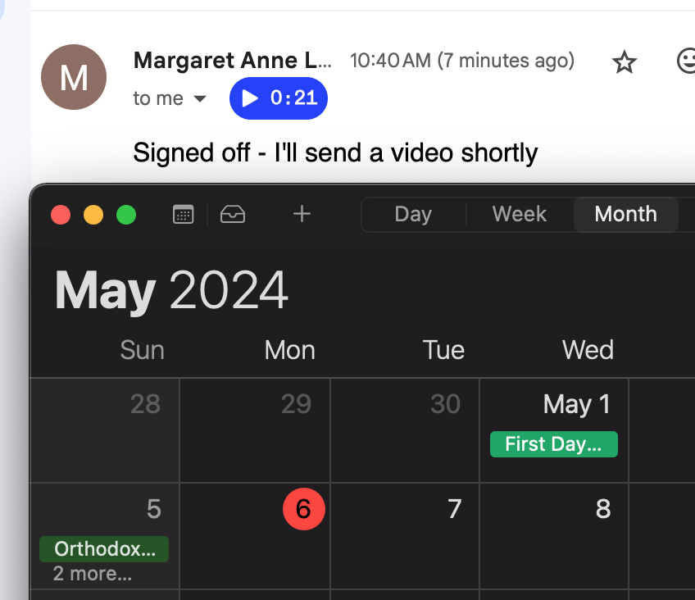
Implementation Challenges
Aaila
Late feedback on report and personas
Final crunch period
Project Closure Delay
IT 493 – Team 2: GMU Website Redesign Team – 05/07/24
Notes:
Our next implementation challenge is project closure delay, we had received late feedback on our report and our personas. It took about 2 weeks to work on our report, receive feedback on that report, and make changes to our report based on the feedback given. Our personas were one of the main focuses for margaret anne and on and off we were working on perfecting those personas. Our final crunch period, within the last week the team worked exceptionally hard on our report to implement the changes asked by margaret. Margaret finally loved our final report and we recently received the sign off on our project!

Slide 25
Documentational Report (Flaws & Issues)
Maryum
Evan
Technical Flaws
Broken Links in Website (Bad User Experience)
Un-Responsive Design on Mobile (Not User Friendly)
Accessibility & Compliance Issues
Missing Alternative Text (section 508 compliance)
Keyboard Accessibility (section 508 compliance)
IT 493 – Team 2: GMU Website Redesign Team – 05/07/24

Slide 26
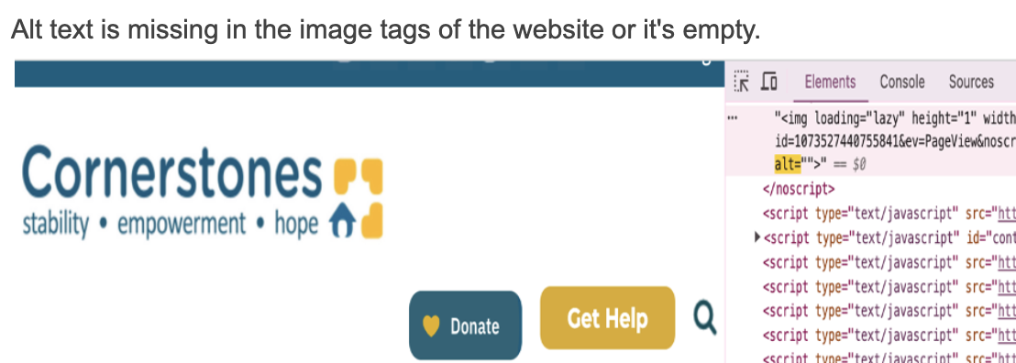
Report Findings
Evan
Maryum
Alt Text
Broken Links
https://www.cornerstonesva.org/?page_id=198
https://www.cornerstonesva.org/childrens-awareness-month-3/
https://www.cornerstonesva.org/on-goingopportunities/
https://www.dominionenergy.com/dominion-virginia-power/index.jsp
https://www.cornerstonesva.org/services/food-financial-or-urgent-assistance/financial-assistance/:%20https:/www.dom.com/residential/dominion-virginia-power/in-the-community/energyshare
https://www.cornerstonesva.org/?page_id=18431

Slide 27

Technical Solutions
Izu
Cornerstones prefers to utilize WordPress as the hosting option; these technical solutions can be incorporated to increase performance and user experience on the Cornerstones website.
To fix the alternative text on the website, using an automated script will improve accessibility and readability.
Loading content externally rather than internally will reduce load time. Plugins like W3 Total Cache and WP Rocket can facilitate the integration process.
IT 492 – Team 2: GMU Website Redesign Team – 05/07/24

Slide 28

Lessons Learned
Jason
Time Management and Scope
Respond to time challenges efficiently and accurately.
Adapt to the changing needs of our project’s scope and timeline.
Apply the feedback from our sponsor to meet their objectives and desired changes.
Confirm that the team and sponsor’s expectations of project scope and deliverables are aligned.
Facilitate open and frequent communication with sponsor.
IT 493 – Team 2: GMU Website Redesign Team – 05/07/24

Slide 29
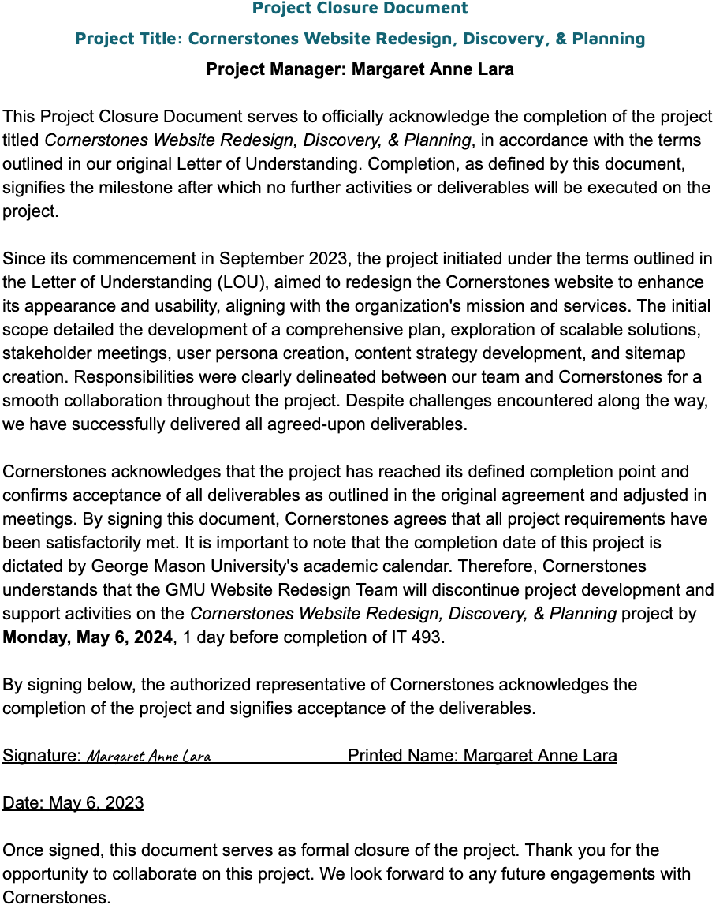
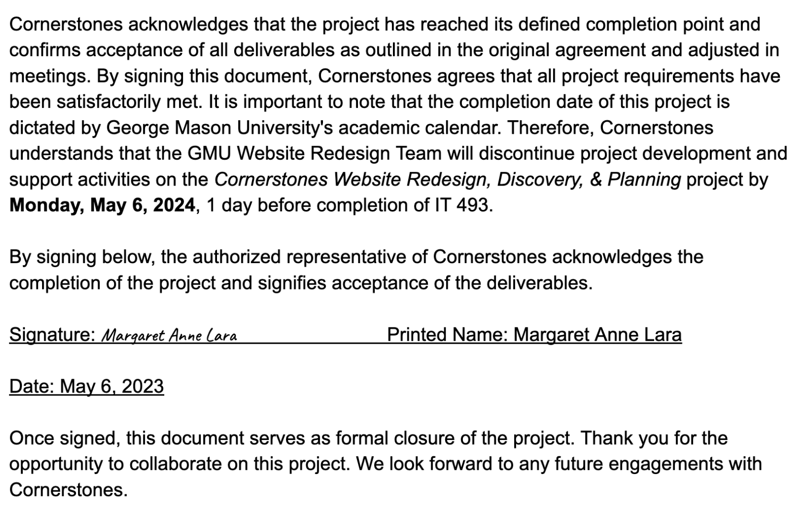
Sponsor’s Seal of Approval - The Sign Off!!
Maryum

Slide 30

Project Sign-Off Video!
Aaila
IT 492 – Team 2: GMU Website Redesign Team – 05/07/24

Slide 31

Aaila
Thank You!
Questions?
IT 493 – Team 2: GMU Website Redesign Team – 05/07/24

